Slide 1
decoupleCZ
查辰

Slide 2
参数
wc = 5.795 * 2 * np.pi # cavity frequency
wq = np.array([ 5.640 , 5.640 , 6.84]) * 2 * np.pi
g = np.array([0.0142 , 0.0142 , 0.0142]) * 2 * np.pi
eta_q = np.array([-0.250 , -0.250 , -0.250]) * 2 * np.pi
omega0 = 0.0159 * 2* np.pi
omega1 = 0.0478 * 2* np.pi
tp = 500
Q0和Q1之间的有效耦合强度为：-0.0013009

Slide 3
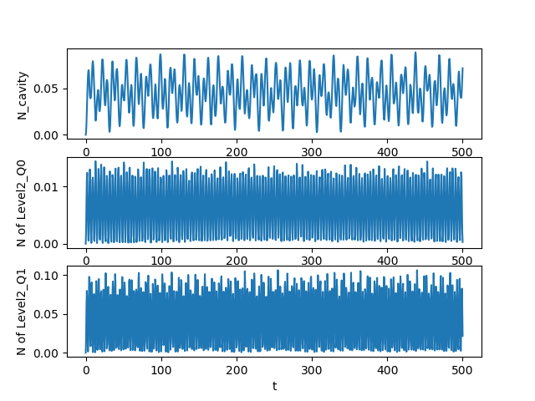
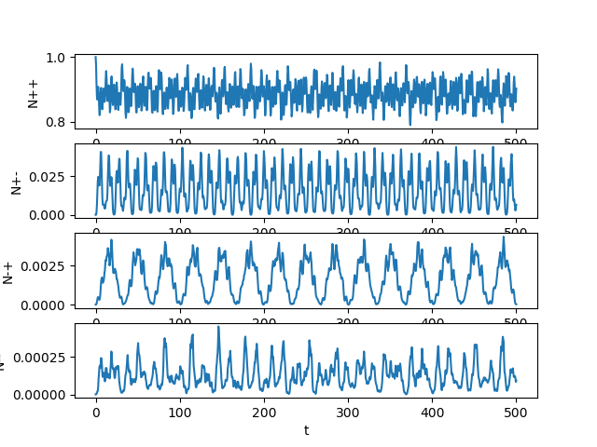
连续
2*omega0*np.cos(wq0 * t)*(0<t<tp)

Slide 4
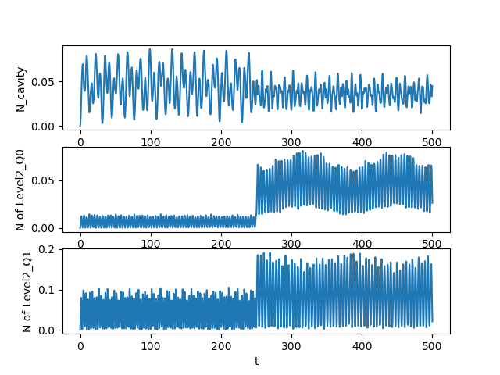
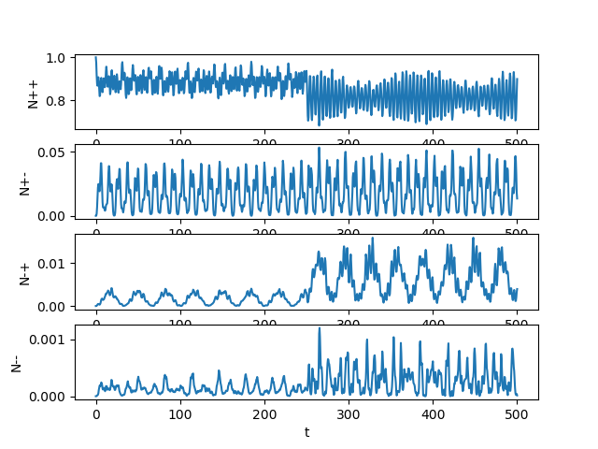
inverse
w0 = '2*omega0*np.cos(wq0 * t)*(0<t<tp/2.0)-2*omega0*np.cos(wq0 * t)*(tp/2.0<t<tp)‘

Slide 5
Erf波形
w0 = '(2*omega0*(-erf((t-tp/2)/(ramp)))*np.cos(wq0 * t)
+np.exp(-(t-tp/2)**2/np.sqrt(pi)/(ramp)**2)/(ramp)/ (eta_q[0])*np.cos(wq0 * t-np.pi/2))*(0<t<tp)'

Slide 6
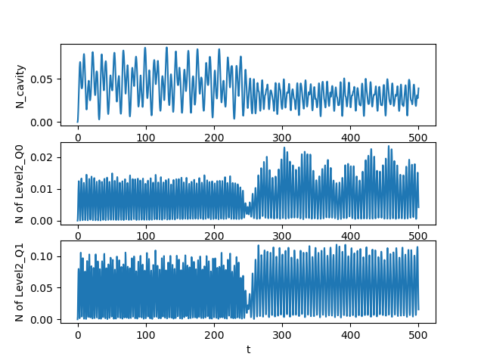
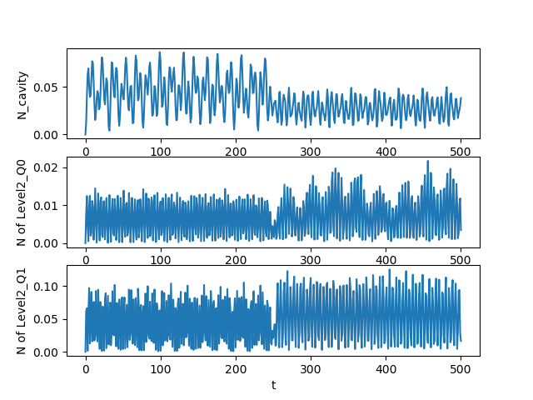
Ramp=10,5,1,0.1

Slide 7
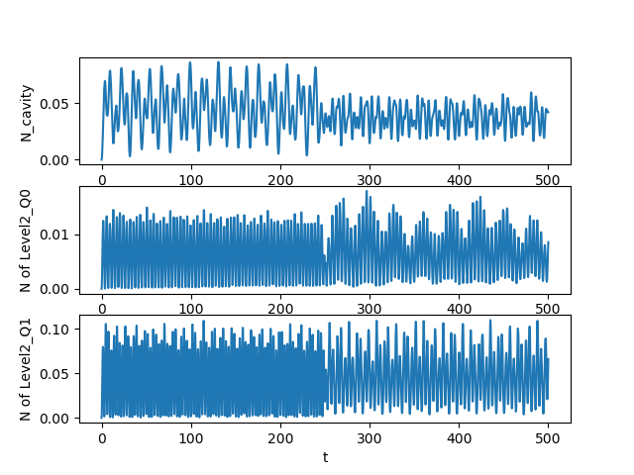
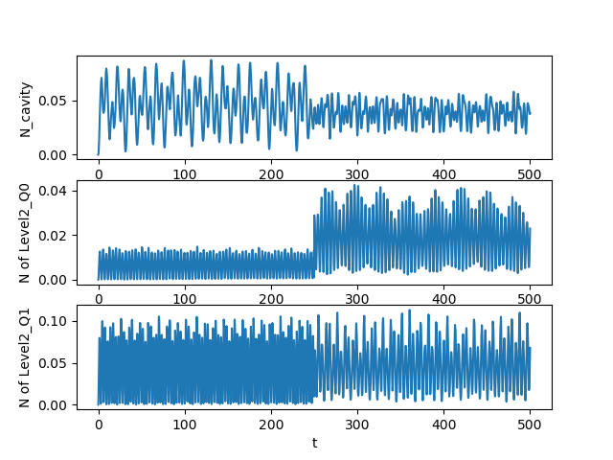
Ramp=10,5,1,0.1

Slide 8
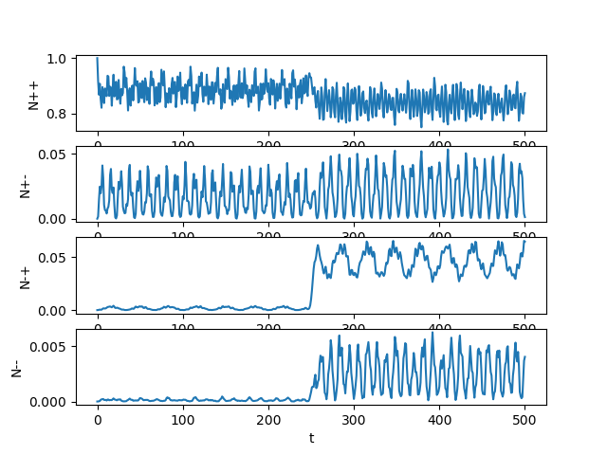
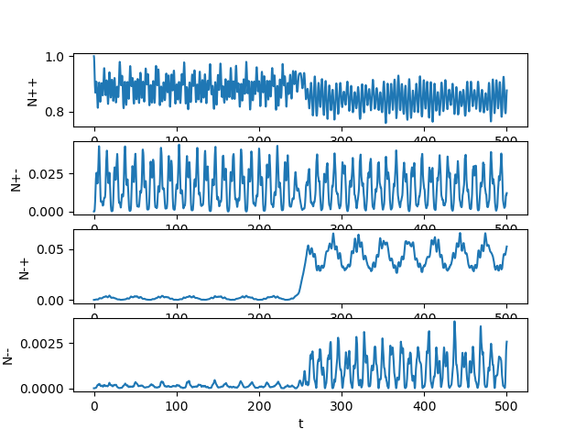
Ramp=10,5,1,0.1

Slide 9
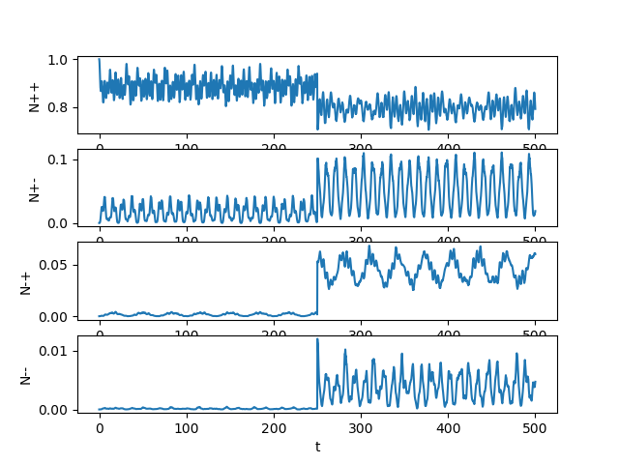
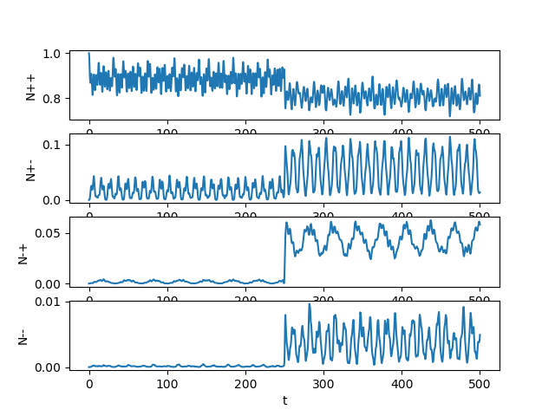
Ramp=10,5,1,0.1

